Slide 1
Divide and conquer: Searching in an Array
http://iti.wtf
Algorithms and Data Structures
Artem A. Golubnichiy
artem@golubnichij.ru
Department of Software of Computer Facilities and Automated Systems
Katanov Khakass State University

Slide 2
STRUCTURE OF THE CLASS
Main Idea of Divide-and-Conquer
Linear Search
Binary Search

Slide 3
a problem to be solved

Slide 4
Divide: Break into non-overlapping subproblems of the same type

Slide 5
Divide: Break into non-overlapping subproblems of the same type

Slide 6
Divide: Break into non-overlapping subproblems of the same type

Slide 7
Divide: Break into non-overlapping subproblems of the same type

Slide 8
Divide: Break into non-overlapping subproblems of the same type

Slide 13
Not the same type

Slide 18
Overlapping

Slide 19
Divide: Break apart

Slide 20
Divide: Break apart

Slide 21
Conquer: Solve subproblems

Slide 22
Conquer: Solve subproblems
✔️

Slide 23
Conquer: Solve subproblems
✔️
✔️

Slide 24
Conquer: Solve subproblems
✔️
✔️
✔️

Slide 25
Conquer: Solve subproblems
✔️
✔️
✔️
✔️

Slide 26
Conquer: combine
✔️
✔️
✔️
✔️

Slide 27
Conquer: combine
✔️
✔️
✔️

Slide 28
Summary
Break into non-overlapping subproblems of the same type
Solve subproblems
Combine results

Slide 29
Linear Search in Array
Ann
Pat
…
Joe
Bob

Slide 30
Linear Search in Array
Ann
Pat
…
Joe
Bob

Slide 31
Linear Search in Array
Ann
Pat
…
Joe
Bob

Slide 32
Linear Search in Array
Ann
Pat
…
Joe
Bob

Slide 33
Linear Search in Array
Ann
Pat
…
Joe
Bob

Slide 34
Linear Search in Array
Ann
Pat
…
Joe
Bob

Slide 35
Real-life Example
English
French
Italian
German
Spanish
house
maison
casa
Haus
casa
car
voiture
auto
Auto
auto
table
table
tavola
Tabelle
mesa

Slide 36
Searching in an array
Input: | An array A with n elements. A key k.
Output: | An index, i, where A[i] = k. If there is no such i, then NOT_FOUND.

Slide 37
Recursive Solution
LinearSearch(A, low , high, key )
if high<low: return NOT_FOUND if A[low] = key: return low

Slide 38
Recursive Solution
LinearSearch(A, low , high, key )
if high<low: return NOT_FOUND if A[low] = key: return low return LinearSearch(A, low+1, high, key)

Slide 39
Definition
A recurrence relation is an equation recursively defining a sequence of values.

Slide 40
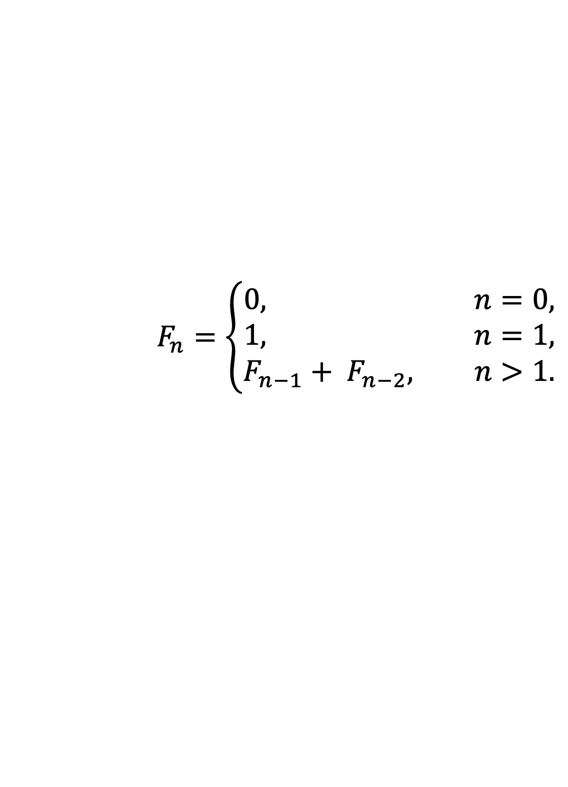
Definition
A recurrence relation is an equation recursively defining a sequence of values.
Fibonacci recurrence relation
$$F_{n}=\left\{\begin{aligned}0, n=0, \\ 1, n=1, \\ F_{n−1}+ F_{n−2}, n>1.\end{aligned}\right.$$

Slide 41
Recursive Solution
LinearSearch(A, low , high, key )
if high<low: return NOT_FOUND if A[low] = key: return low return LinearSearch(A, low+1, high, key)

Slide 42
Recursive Solution
LinearSearch(A, low , high, key )
if high<low: return NOT_FOUND if A[low] = key: return low return LinearSearch(A, low+1, high, key)
Recurrence defining worst-case time:
T (n) = T (n −1) + c

Slide 43
Recursive Solution
LinearSearch(A, low , high, key )
if high<low: return NOT_FOUND if A[low] = key: return low return LinearSearch(A, low+1, high, key)
Recurrence defining worst-case time:
T (n) = T (n −1) + c
T (0) = c

Slide 44
Runtime of Linear Search
n
n-1
n-2
・
・
・
2
1

Slide 45
Runtime of Linear Search
work
n
c
n-1
c
n-2
c
・
・
・
2
c
1
c

Slide 46
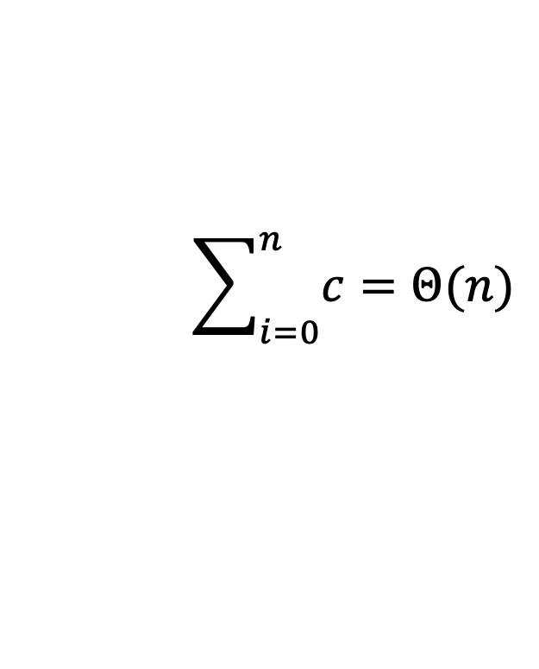
Runtime of Linear Search
work
n
c
n-1
c
n-2
c
・
・
・
2
c
1
c
$$\sum_{i=0}^{n}{c=Θ(n)}$$
Total:

Slide 47
Iterative Version
LinearSearchIt(A, low , high, key )
for i from low to high: if A[i] = key: return i return NOT_FOUND

Slide 48
Summary
Create a recursive solution

Slide 49
Summary
Create a recursive solution Define a corresponding recurrence relation, T

Slide 50
Summary
Create a recursive solution Define a corresponding recurrence relation, T Determine T(n): worst-case runtime

Slide 51
Summary
Create a recursive solution Define a corresponding recurrence relation, T Determine T(n): worst-case runtime
Optionally, create iterative solution

Slide 52
Searching Sorted Data

Slide 53
Searching in a sorted array
Input: | A sorted array A[low . . . high] (∀low ≤ i < high : A[i] ≤ A[i + 1]). A key k.
Output: | An index, i, (low ≤ i ≤ high) where A[i] = k. Otherwise, the greatest index i, where A[i] < k. Otherwise (k < A[low]), the result is low − 1.

Slide 54
Searching in a Sorted Array
Example
3
5
8
20
20
50
60
1
2
3
4
5
6
7

Slide 55
Searching in a Sorted Array
Example
search(2) → 0
3
5
8
20
20
50
60
1
2
3
4
5
6
7

Slide 56
Searching in a Sorted Array
Example
search(2) → 0 search(3) → 1
3
5
8
20
20
50
60
1
2
3
4
5
6
7

Slide 57
Searching in a Sorted Array
Example
search(2) → 0 search(3) → 1 search(4) → 1
3
5
8
20
20
50
60
1
2
3
4
5
6
7

Slide 58
Searching in a Sorted Array
Example
search(2) → 0 search(20) → 4 search(3) → 1 search(4) → 1
3
5
8
20
20
50
60
1
2
3
4
5
6
7

Slide 59
Searching in a Sorted Array
Example
search(2) → 0 search(20) → 4 search(3) → 1 search(20) → 5 search(4) → 1
3
5
8
20
20
50
60
1
2
3
4
5
6
7

Slide 60
Searching in a Sorted Array
Example
search(2) → 0 search(20) → 4 search(3) → 1 search(20) → 5 search(4) → 1 search(60) → 7
3
5
8
20
20
50
60
1
2
3
4
5
6
7

Slide 61
Searching in a Sorted Array
Example
search(2) → 0 search(20) → 4 search(3) → 1 search(20) → 5 search(4) → 1 search(60) → 7 search(70) → 7
3
5
8
20
20
50
60
1
2
3
4
5
6
7

Slide 62
Searching in a Sorted Array
BinarySearch(A, low , high, key )
if high<low: return low − 1

Slide 63
Searching in a Sorted Array
BinarySearch(A, low , high, key )
if high<low: return low − 1 mid ← [low + (high−low)/2] ︁

Slide 64
Searching in a Sorted Array
BinarySearch(A, low , high, key )
if high<low: return low − 1 mid ← [low + (high−low)/2] ︁ if key = A[mid]: return mid

Slide 65
Searching in a Sorted Array
BinarySearch(A, low , high, key )
if high<low: return low − 1 mid ← [low + (high−low)/2] ︁ if key = A[mid]: return mid else if key < A[mid]: return BinarySearch(A, low, mid−1, key)

Slide 66
Searching in a Sorted Array
BinarySearch(A, low , high, key )
if high<low: return low − 1 mid ← [low + (high−low)/2] ︁ if key = A[mid]: return mid else if key < A[mid]: return BinarySearch(A, low, mid−1, key) else: return BinarySearch(A, mid+1, high, key)

