Slide 1
Introduction: Big-O Notation
http://iti.wtf
Algorithms and Data Structures
Artem A. Golubnichiy
artem@golubnichij.ru
Department of Software of Computer Facilities and Automated Systems
Katanov Khakass State University

Slide 2
STRUCTURE OF THE CLASS
Understand the meaning of Big-O notation.
Describe some of the advantages and disadvantages of using Big-O notation.
Manipulate expressions involving Big-O and other asymptotic notation.
Compute algorithm runtimes in terms of Big-O.

Slide 3
BIG-O NOTATION
Definition
f(n) = O(g(n)) (f is Big-O of g) or f ⪯ g if there exist constants N and c so that for all n ≥ N, f (n) ≤ c · g(n).
f is bounded above by some constant multiple of g.

Slide 4
BIG-O NOTATION
Example
3n² + 5n + 2 = O(n²) since if n ≥ 1, 3n² + 5n + 2 ≤ 3n² + 5n² + 2n² = 10n².

Slide 5
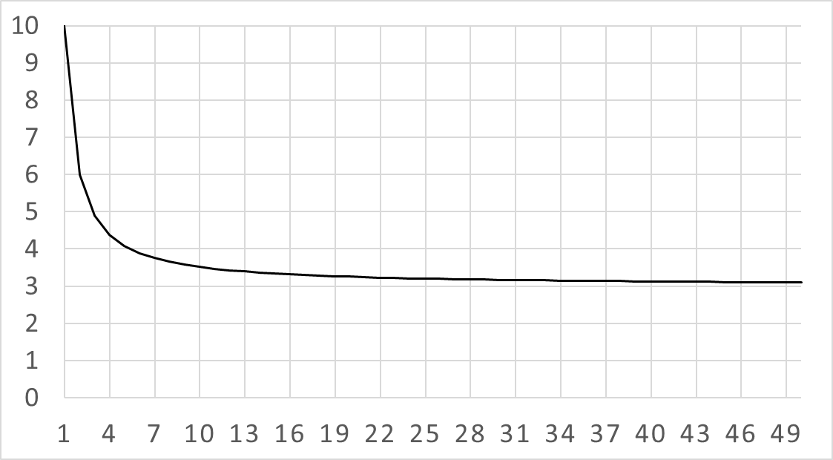

GROWTH RATE
3n² + 5n + 2 has the same growth rate as n²
$$\frac{3n^{2}+5n+2}{n^{2}}$$

Slide 6
USING BIG-O
We will use Big-O notation to report algorithm runtimes. This has several advantages.

Slide 7
CLEANS UP NOTATION
O(n²) vs. 3n² + 5n + 2.
O(n) vs. n + log₂(n) + sin(n).
O(n log(n)) vs. 4n log₂(n) + 7.
Note: log₂(n), log₃(n), log_{x} (n) differ by constant multiples, don’t need to specify which.
Makes algebra easier.

Slide 8
WARNING
Using Big-O loses important information about constant multiples.
Big-O is only asymptotic.

Slide 9
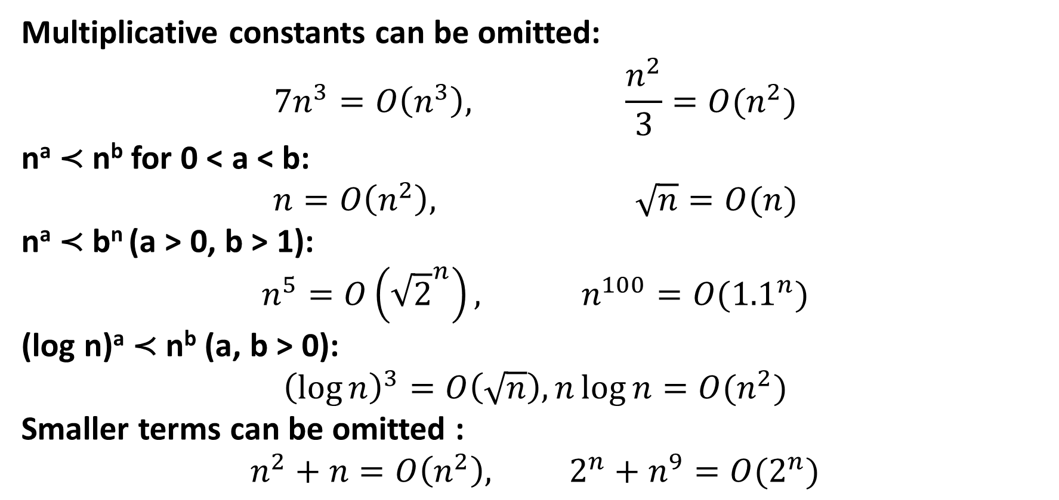
COMMON RULES
Multiplicative constants can be omitted:
$$7n^{3}=O\left(n^{3}\right), \frac{n^{2}}{3}=O(n^{2})$$
nª ≺ n^{b} for 0 < a < b:
$$n=O\left(n^{2}\right), \sqrt{n}=O(n)$$
nª ≺ b^{n} (a > 0, b > 1):
$$n^{5}=O\left({\sqrt{2}}^{n}\right), n^{100}=O({1.1}^{n})$$
(log n)ª ≺ n^{b} (a, b > 0):
$${\left(\log{n}\right)}^{3}=O\left(\sqrt{n}\right), n\log{n}=O(n^{2})$$
Smaller terms can be omitted :
$$n^{2}+n=O\left(n^{2}\right), 2^{n}+n^{9}=O(2^{n})$$

Slide 10
RECALL ALGORITHM
FibList(n)
create an array F[0 …n] F[0] ← 0 F[1] ← 1 for i from 2 to n: F[i] ← F[i – 1] + F[i – 2] return F[n]

Slide 11
BIG-O IN PRACTICE
Operation | Runtime
create an array F[0 …n] F[0] ← 0 F[1] ← 1 for i from 2 to n: F[i] ← F[i – 1] + F[i – 2] return F[n] | O(n) O(1) O(1) Loop O(n) times O(n) O(1)
Total:
O(n)+O(1)+O(1)+O(n)·O(n)+O(1) = O(n²).

Slide 12
OTHER NOTATION
Definition
For functions f , g : N → R⁺ we say that: f (n) = Ω(g(n)) or f ⪰ g if for some c, f (n) ≥ c · g(n) (f grows no slower than g). f (n) = Θ(g(n)) or f ≍ g if f = O(g) and f = Ω(g) (f grows at the same rate as g). f (n) = o(g(n)) or f ≺ g if f (n)/g(n) → 0 as n → ∞ (f grows slower than g).

Slide 13
ASYMPTOTIC NOTATION
Lets us ignore messy details in analysis.
Produces clean answers.
Throws away a lot of practically useful information.

