Slide 1
Introduction: Asymptotic Notation
http://iti.wtf
Algorithms and Data Structures
Artem A. Golubnichiy
artem@golubnichij.ru
Department of Software of Computer Facilities and Automated Systems
Katanov Khakass State University

Slide 2
STRUCTURE OF THE CLASS
Understand the basic idea behind asymptotic runtimes.
Describe some of the advantages to using asymptotic runtimes.

Slide 3
APPROXIMATE RUNTIMES
 | n | n log n | n2 | 2n
n = 20 | 1 sec | 1 sec | 1 sec | 1 sec
n = 50 | 1 sec | 1 sec | 1 sec | 13 day
n = 10² | 1 sec | 1 sec | 1 sec | 4 · 10¹³ year
n = 10⁶ | 1 sec | 1 sec | 17 min
n = 10⁹ | 1 sec | 30 sec | 30 year
max n (1 sec) | 10⁹ | 10^{7.5} | 10^{4.5} | 30

Slide 4
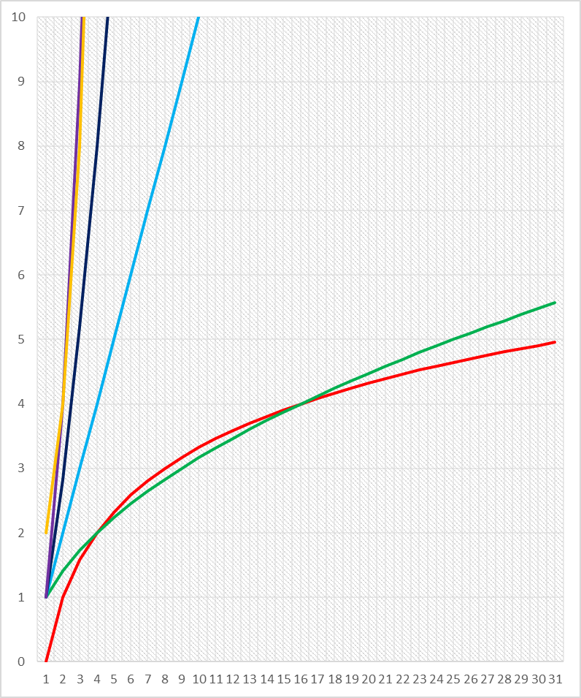
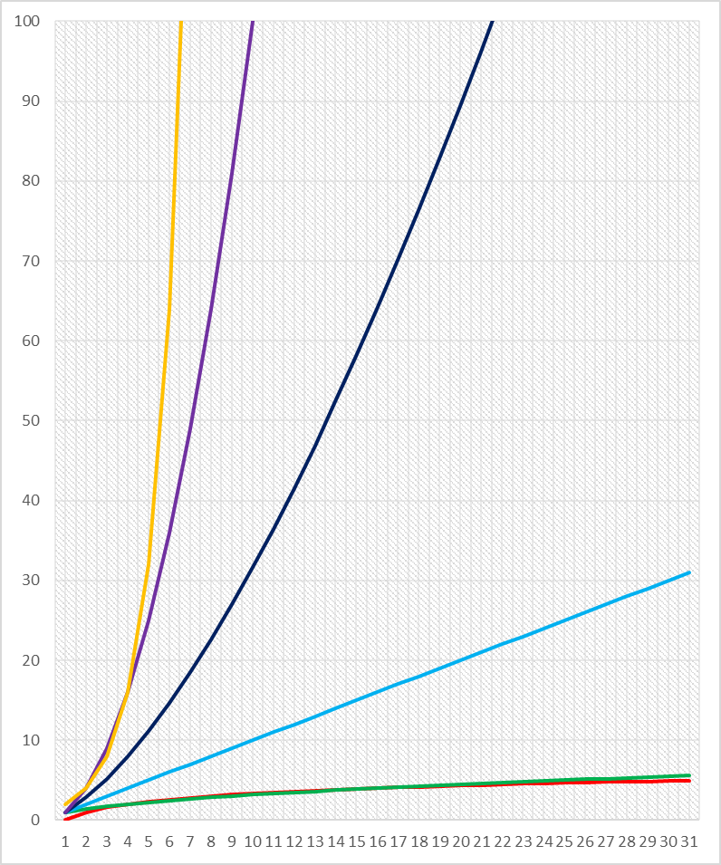
$$\log_{2}{n<\sqrt{n}<}n<n \log_{2}{n}<n^{2}<2^{n}$$

