Slide 1
Introduction: Why Study Algorithms?
http://iti.wtf
Algorithms and Data Structures
Artem A. Golubnichiy
artem@golubnichij.ru
Department of Software of Computer Facilities and Automated Systems
Katanov Khakass State University

Slide 2
STRUCTURE OF THE CLASS
Straightforward Programming Problems;
Simple Programming Problems;
Algorithms Problems;
Artificial Intelligence Problems.

Slide 3
STRAIGHTFORWARD PROGRAMMING PROBLEMS
Has straightforward implementation;
Natural solution is already efficient.

Slide 4
STRAIGHTFORWARD PROGRAMMING PROBLEMS
Has straightforward implementation;
Natural solution is already efficient.
Display given text

Slide 5
STRAIGHTFORWARD PROGRAMMING PROBLEMS
Has straightforward implementation;
Natural solution is already efficient.
Display given text
Copy a File

Slide 6
STRAIGHTFORWARD PROGRAMMING PROBLEMS
Has straightforward implementation;
Natural solution is already efficient.
Display given text
Copy a File
Search for a Given Word

Slide 7
SIMPLE PROGRAMMING PROBLEMS
Has linear scan;
Cannot do much better;
The obvious program works.

Slide 8
SIMPLE PROGRAMMING PROBLEMS
Has linear scan;
Cannot do much better;
The obvious program works.
Example problem:
Write a program that asks the user for their name and greets them with their name.

Slide 9
SIMPLE PROGRAMMING PROBLEMS
Has linear scan;
Cannot do much better;
The obvious program works.
Example problem:
Write a program that asks the user for their name and greets them with their name.
Example solution (Python 3):
name = input("Hello! Please type your name: ")
print("Hello, " + name + "!")

Slide 10
ALGORITHMS PROBLEMS
Not clear how to do
Simple ideas too slow
Room for optimization

Slide 11
ALGORITHMS PROBLEMS
Not clear how to do
Simple ideas too slow
Room for optimization
Measure Similarity of Documents

Slide 12
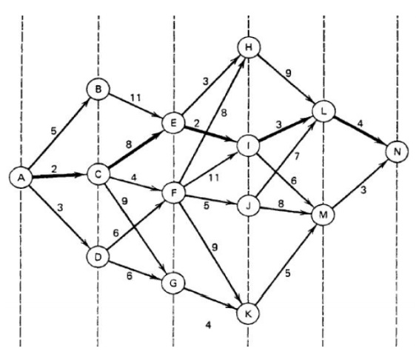
ALGORITHMS PROBLEMS
Not clear how to do
Simple ideas too slow
Room for optimization
Measure Similarity of Documents
Find the Shortest Path Between Locations

Slide 13
ALGORITHMS PROBLEMS
Not clear how to do
Simple ideas too slow
Room for optimization
Focus on algorithms problems:
Clearly formulated.
Hard to do efficiently.
Measure Similarity of Documents
Find the Shortest Path Between Locations

Slide 14
ARTIFICIAL INTELLIGENCE PROBLEMS
Hard to even clearly state.

Slide 15
ARTIFICIAL INTELLIGENCE PROBLEMS
Hard to even clearly state.
Understand Natural Language

Slide 16
ARTIFICIAL INTELLIGENCE PROBLEMS
Hard to even clearly state.
Understand Natural Language
Identify Objects In Photographs

Slide 17
ARTIFICIAL INTELLIGENCE PROBLEMS
Hard to even clearly state.
Understand Natural Language
Identify Objects In Photographs
Play Games Well

